Slide 1

Specialty Classification
from Medical Transcription

Slide 2
Problem Statement :
The goal of this project is to develop a classifier that can classify medical transcriptions into different medical specialties.
We chose to implement supervised classification Machine Learning & Deep Learning models - to see if we were able to correctly classify the medical specialty based on the transcription text.

Slide 3
Real Life Application (Motivation)
Accurate classification helps send reports and patient data to the right specialist or department, saving time and reducing paperwork which allows healthcare providers to focus on critical cases quickly by categorizing urgent cases based on medical specialty.
Can be used for training healthcare professionals by providing examples of how cases align with medical specialties.

Slide 4
Contributions per member
Mumuksha:
Conducted Exploratory Data Analysis
Applied Word2Vec vectorization
Trained Logistic Regression with different vectorizers and hyperparameters
Pragya:
Worked on EDA and developed a data cleaning pipeline with test cases
Applied TF-IDF vectorization
Trained Random Forest with different vectorizers and hyperparameters
Pratham:
Worked on creating a data cleaning function and its testing
Performed feature engineering-combining and dropping categories aided by NER
Applied ClinicalBERT vectorization
Trained RoBERTa and SVM with different embeddings
Trained LSTM model using ClinicalBERT embeddings
Team work:
Model comparison, evaluated model performance using appropriate metrics
Cleaned and optimized code
Worked on Unit tests, Demo, PPT, Report

Slide 5
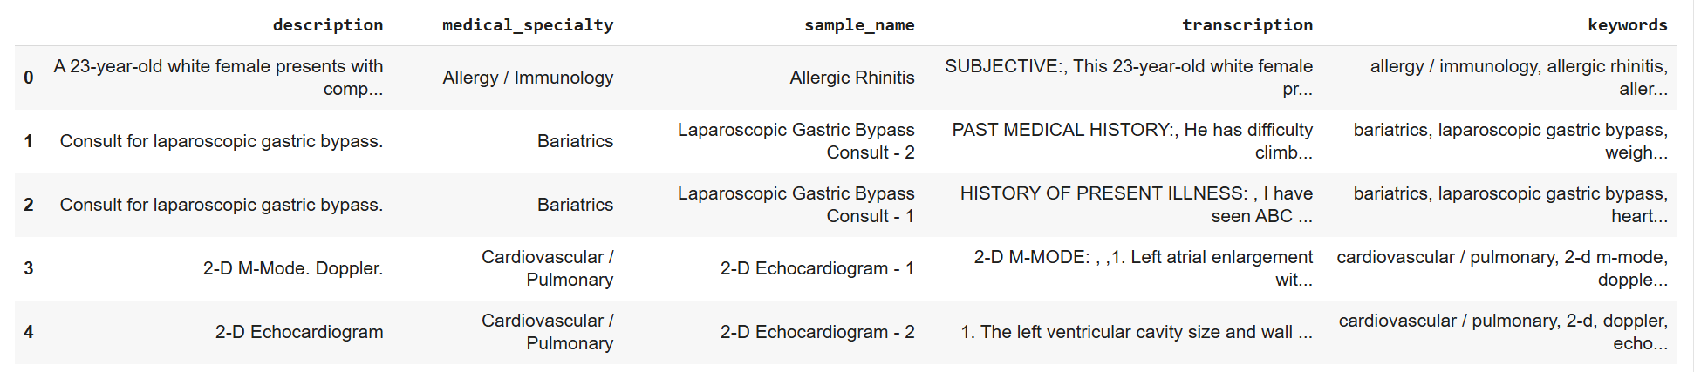
Dataset
The dataset contains 4,998 data points with the following columns:
description
Medical_speciality ( target variable )
sample_name
transcription
keywords

Slide 6
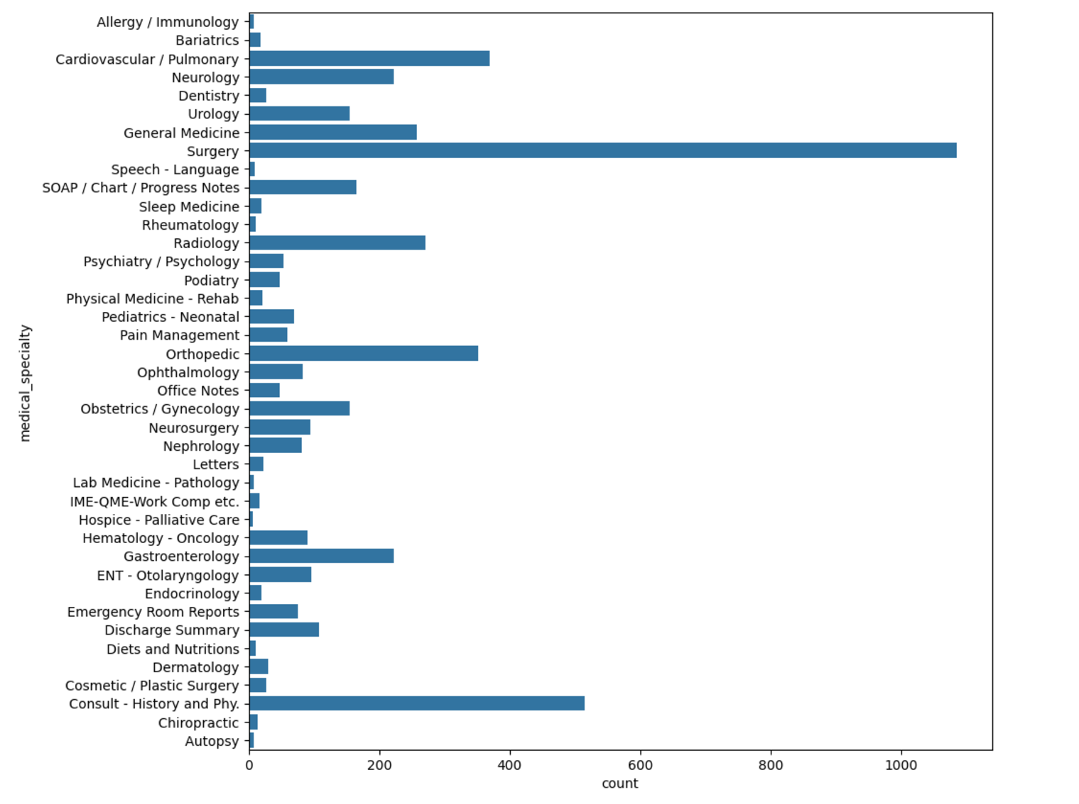
Transcription count per specialty
This graph helps in understanding the distribution of data across different medical specialties.
Based on this we removed the underrepresented specialties which ensures the classifier focuses on specialties with sufficient data to learn patterns effectively

Slide 7
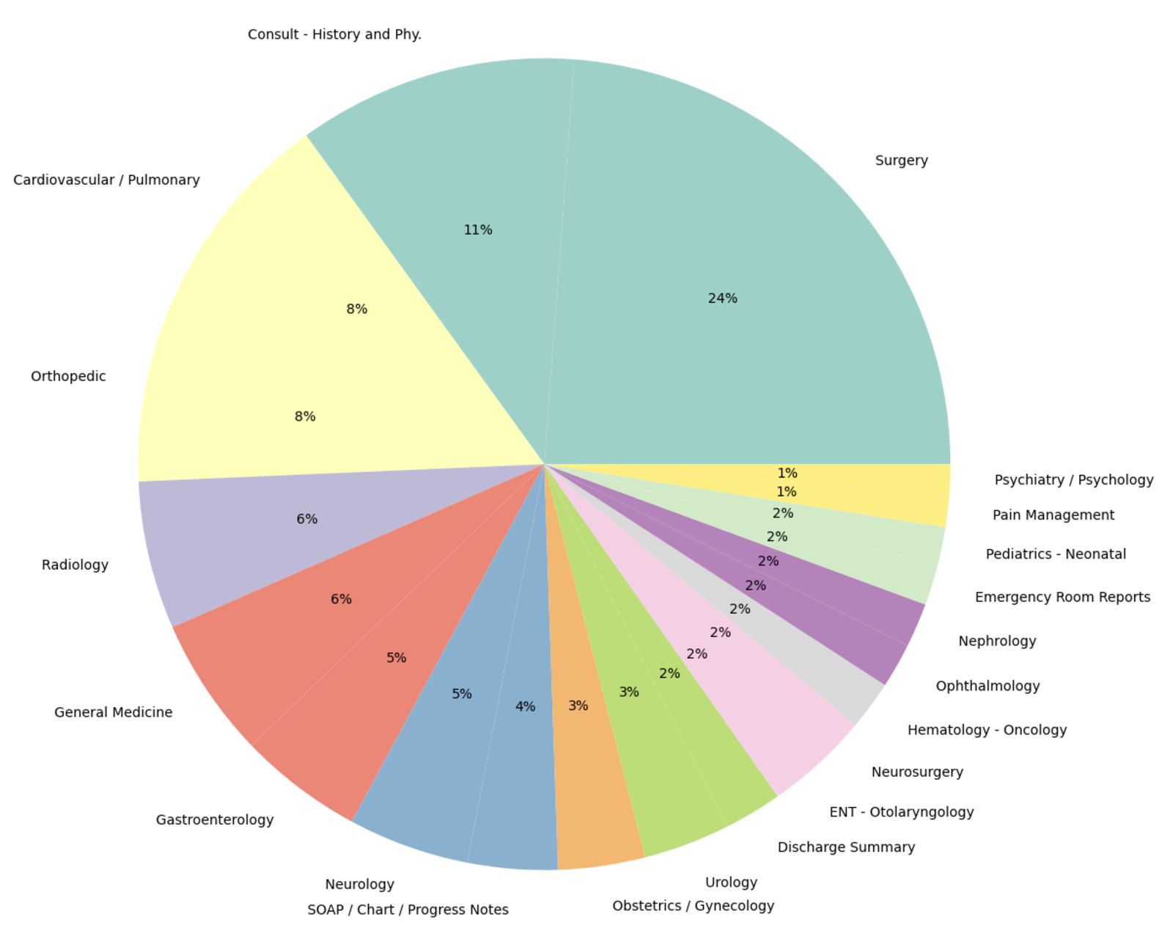
This graph shows the number of transcriptions for the top 21 categories.
We are keeping the top 6 categories: Cardiovascular/Pulmonary, General Medicine, Neurology, Orthopedic, Radiology, and Surgery

Slide 8
Data Preprocessing
Wrote a comprehensive cleaning function for removing hyphens, HTML Tags, URL, special characters,etc since this data was scraped from the web.
Performed lemmatization and stopwords removal
Performed feature engineering by combining categories belonging to similar domain (Consult - History and Physical and General Medicine) & (Neurosurgery and Neurology)

Slide 9
Vectorization techniques
TF IDF
Word2vec
ClinicalBERT

Slide 10
TF IDF - (Term Frequency Inverse Document Frequency)
TF-IDF is a common technique for vectorizing text into numerical features for machine learning models.
It measures how important a word is in a document compared to a corpus.
A word gets a higher score if it appears many times in one document but is rare across the whole dataset.

Slide 11
Word2vec
word2vec creates word embeddings - which are numerical representations of words.
We are using skip-gram because:
Skip-gram predicts context words given a target word.
It is better suited for capturing meaningful embeddings of rare words.
Medical transcription involves technical terms, many of which are rare (e.g., "hemangioblastoma," "pneumothorax")
Skip-Gram is a method that’s really good at learning about these rare words because it looks at the words that appear around them (their context) to figure out their meaning.

Slide 12
ClinicalBERT
ClinicalBERT, is a BERT model specifically designed for clinical text processing. The model is pre-trained on a large corpus of clinical notes from the MIMIC-III dataset
It provides a more contextual way to vectorize medical transcription data by leveraging its domain-specific knowledge and better handling of medical language nuances.

Slide 13
Models and Metrics

Slide 14
Proposed Methods
Logistic Regression
Support Vector Machine
Random Forest
RoBERTa
LSTM

Slide 15
Logistic Regression
Logistic regression is a statistical method used for binary classification that models the probability of an outcome using a sigmoid function.

Slide 16
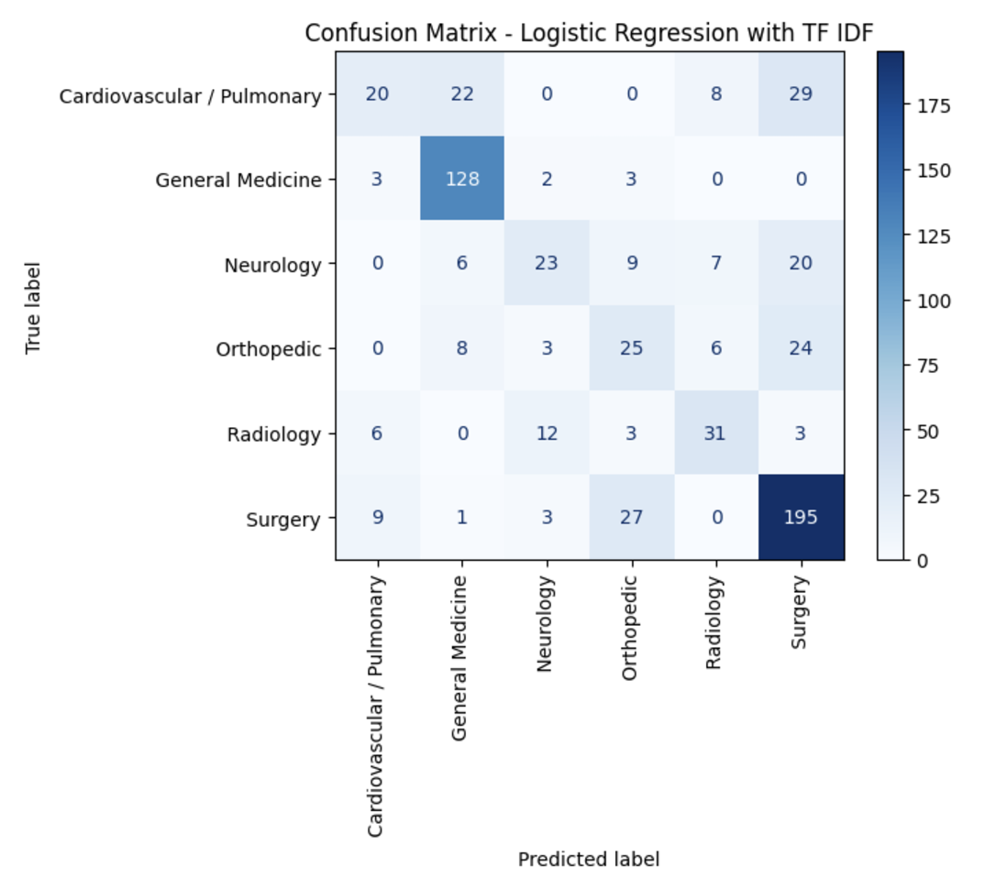
Logistic regression : TF IDF
Trained model with hyperparameters: max_iter=1000, solver='liblinear'
The diagonal cells represent the correctly classified instances for each category.
The model is better at identifying : Surgery (195) and General Medicine (128)
Cardiovascular/Pulmonary has significant misclassifications into "Surgery" (29 cases) and "General Medicine" (22 cases)
Orthopedic is often misclassified as "Surgery" (24 cases)

Slide 17
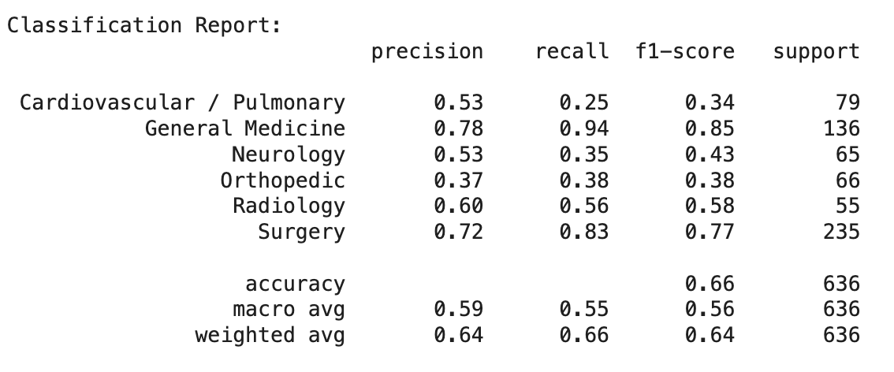
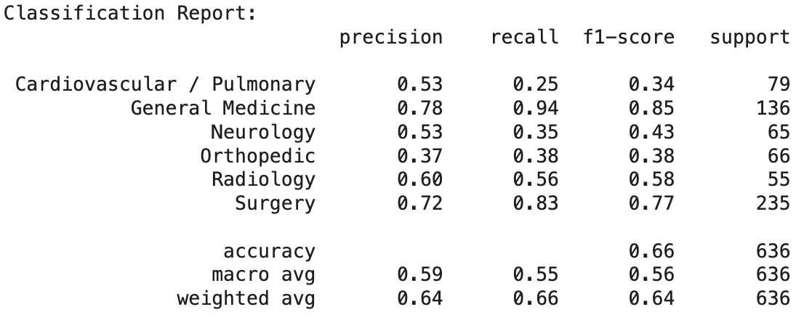
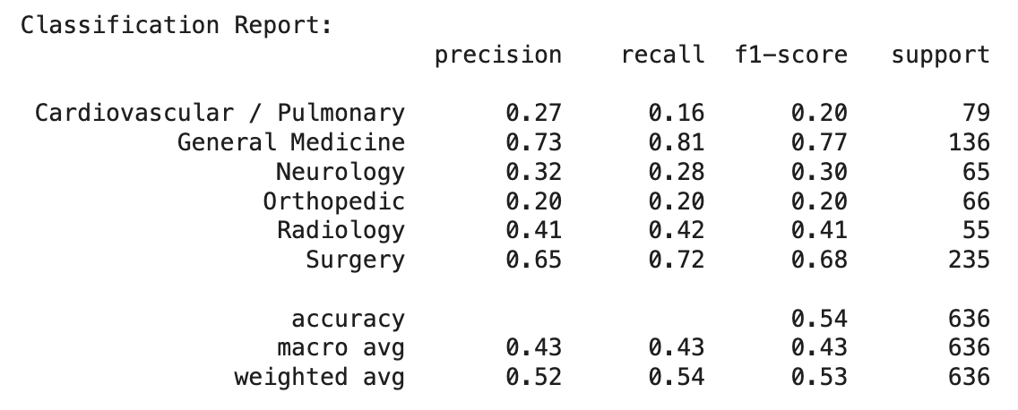
Logistic Regression Comparison
Accuracy -
TF IDF, Word2Vec : 66 %
ClinicalBERT : 54 %
TF IDF and W2Vec models are simpler, so they are less likely to overfit on small datasets.
ClinicalBERT struggles, likely because it is trained for general clinical text representation tasks.

Slide 18
Random Forest
Random Forest is an ensemble learning algorithm that combines multiple decision trees to improve classification accuracy and reduce overfitting.

Slide 19
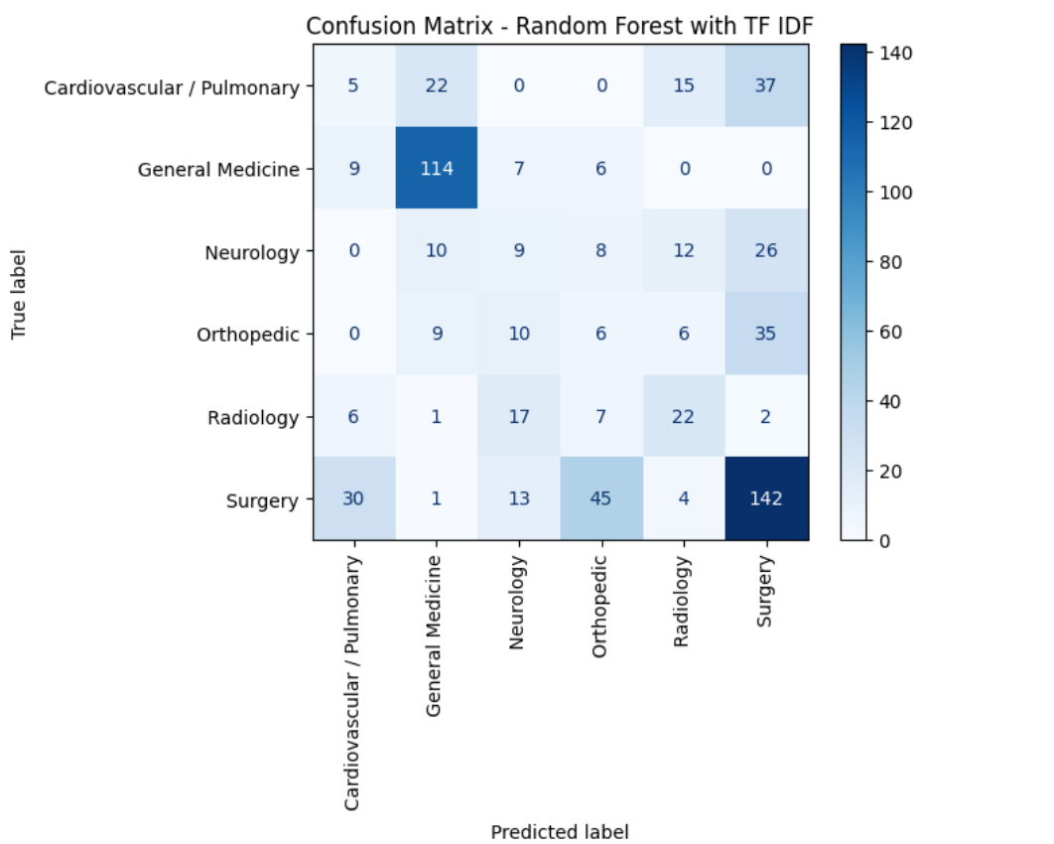
Random forest: TF-IDF
The rows represent the true labels (actual categories).
The columns represent the predicted labels (model predictions).
Diagonal values represent correct classifications. The model correctly classifies Surgery (142) and General Medicine (144) with high classification rate.
“Cardiovascular / Pulmonary”, have the significant misclassification with “Surgery” (37 instances).
“Orthopedic” have the significant misclassification as “Surgery”(35 instances).

Slide 20
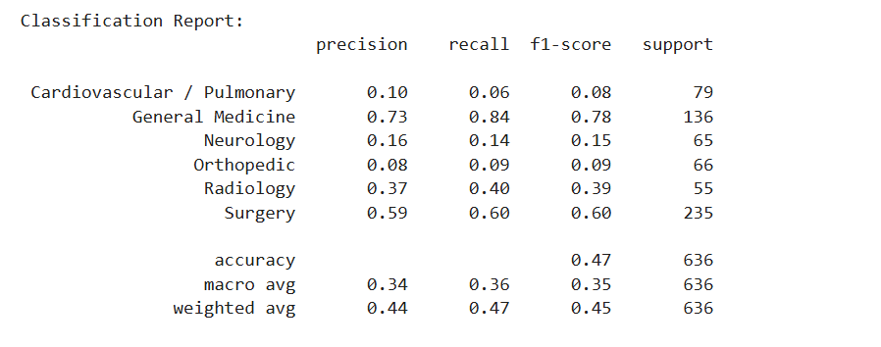
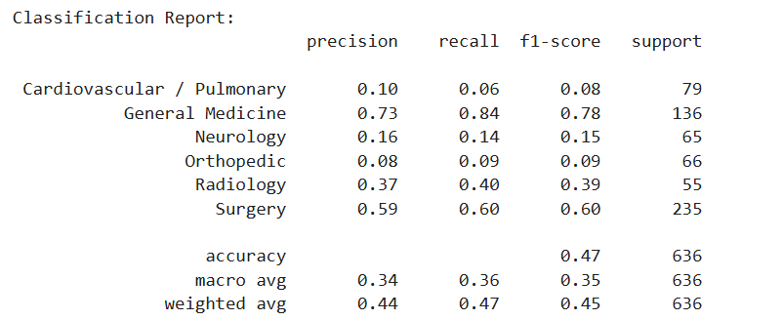
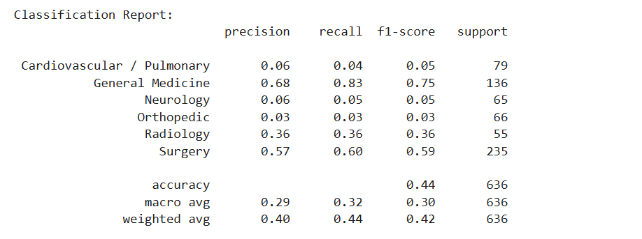
Random forest
Comparison
Accuracy:
TF-IDF and Word2Vec - 47%
ClinicalBERT - 44%
TF-IDF and Word2Vec performed slightly better than ClinicalBERT.
General Medicine and Surgery consistently perform well, achieving high precision, recall, and F1-scores due to distinctive feature representation and better class support.
BERT struggled to perform well due to lack of sufficient data, class imbalance or inadequate fine-tuning

Slide 21
Support Vector Machine
(A supervised machine learning algorithm that finds the optimal hyperplane to separate data into distinct classes in a high-dimensional space)

Slide 22
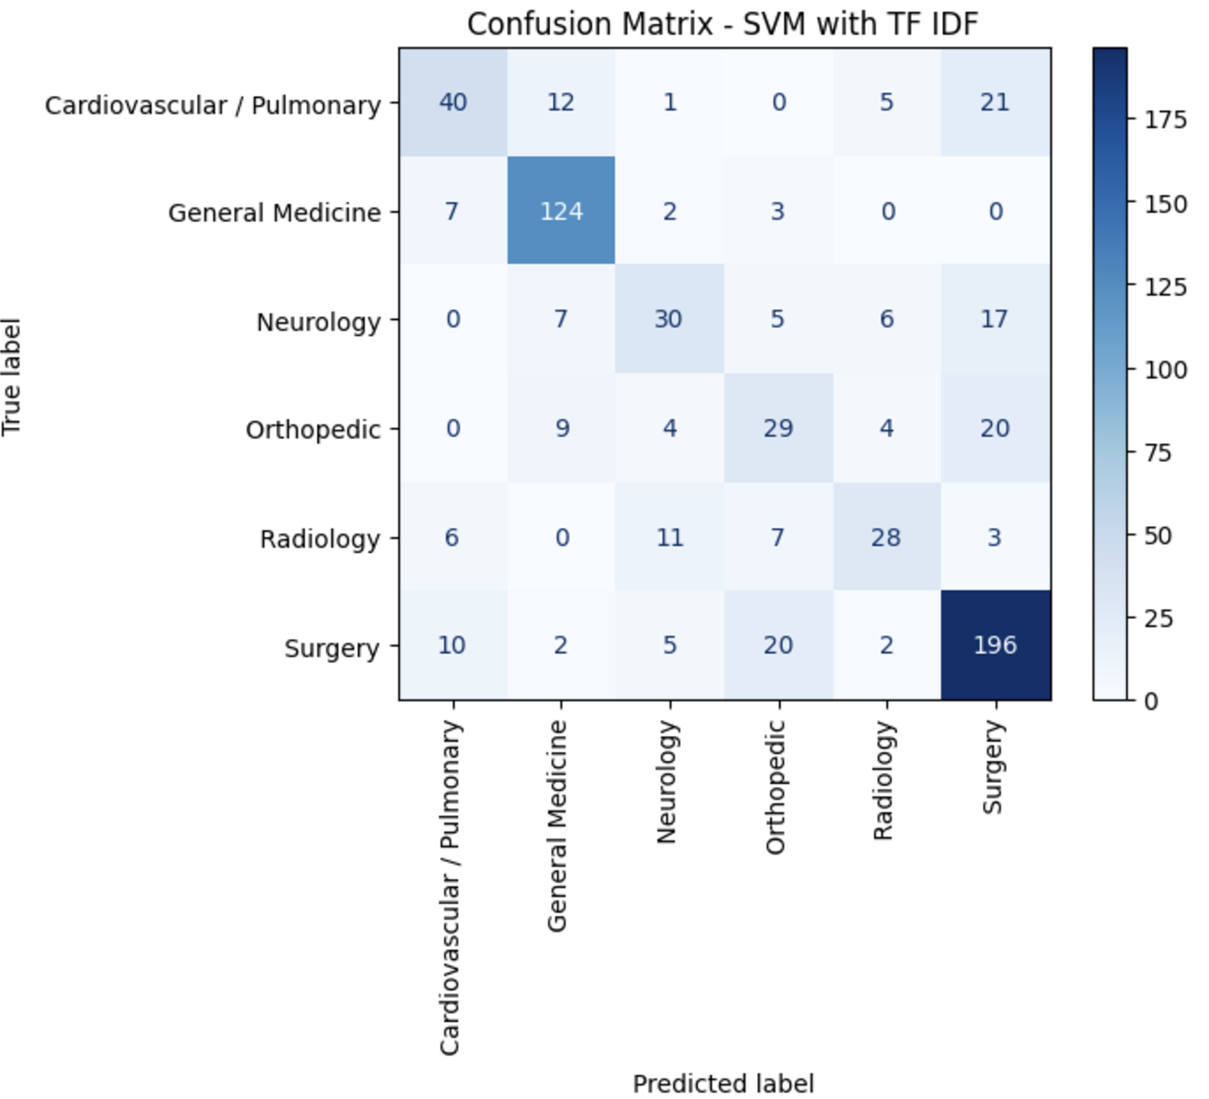
SVM : TF IDF
The model is better at identifying : Surgery (196) and General Medicine (124) because they have relatively high correct classification rates.
Cardiovascular/Pulmonary has some misclassifications into "Surgery" (21 cases) and "General Medicine" (12 cases)
Orthopedic is often misclassified as "Surgery" (20 cases)

Slide 23
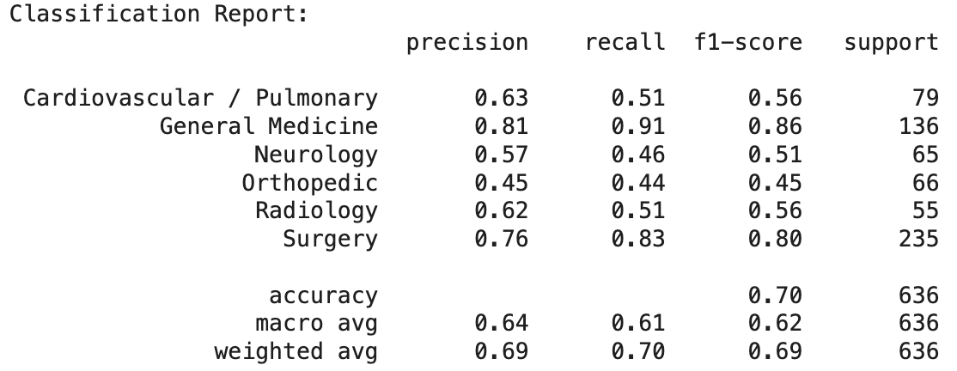

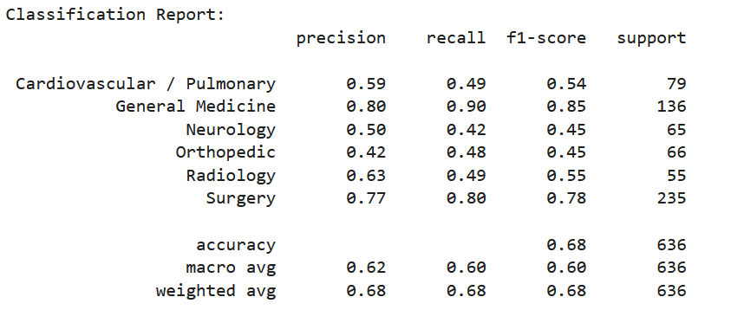

SVM Comparison
Accuracy:
TF IDF, Word2Vec : 70 %
ClinicalBERT: 64 %
TF-IDF and Word2Vec perform equally well

Slide 24
RoBERTa
(A Robustly Optimized BERT Pretraining Approach with modified hyperparameters and pre-training steps)

Slide 25
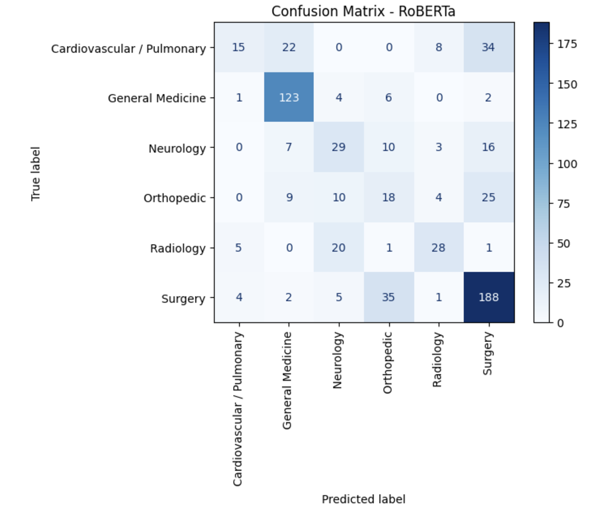
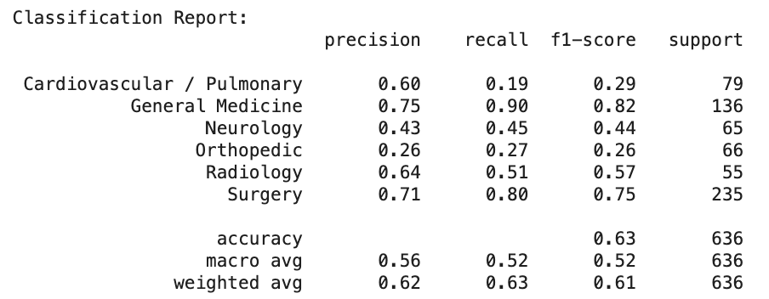
RoBERTa
Accuracy: 63%
The model is better at identifying : Surgery (188) and General Medicine (123)
Cardiovascular/Pulmonary has significant misclassifications into "Surgery" (34 cases) and "General Medicine" (22 cases)
It also struggled with Radiology

Slide 26
LSTM
Long Short-Term Memory (LSTM) is a type of recurrent neural network (RNN) designed to capture long-term dependencies in sequential data by using memory cells and gating mechanisms

Slide 27
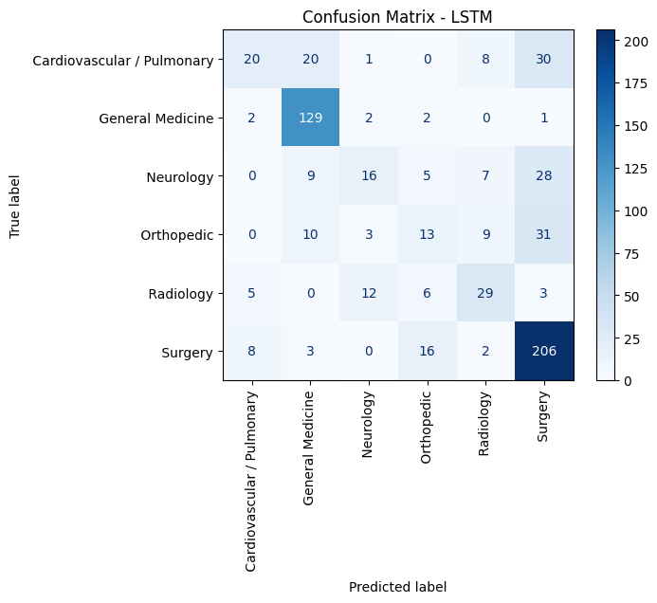
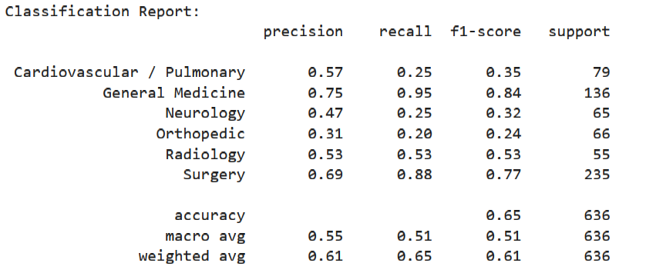
LSTM
Accuracy: 65%
The model is better at identifying : Surgery (206) and General Medicine (129)
Cardiovascular/Pulmonary has significant misclassifications into "Surgery" and "General Medicine"
This model also struggled with Neurology as it had more misclassifications

Slide 28
Interesting Findings
All our models struggled in differentiating between cardiovascular and surgery, and orthopedic and surgery
Even with the use of ClinicalBERT, which incorporates domain-specific knowledge as a vectorizer, we observed no significant improvement in performance compared to TF-IDF and Word2Vec
Interestingly, TF-IDF and Word2Vec produced identical accuracy levels across all models.

Slide 29
Challenges Faced
Lack of extensive medical transcriptions due to HIPAA regulations
Complex medical terms
More domain knowledge would have been helpful
Common medical terms across different classes

Slide 30
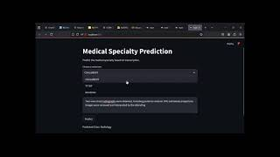
Demo
Video Link: https://youtu.be/2Ss_knLWzi8

Slide 31
Thank you!
Presented by Team 102

